Slide 1
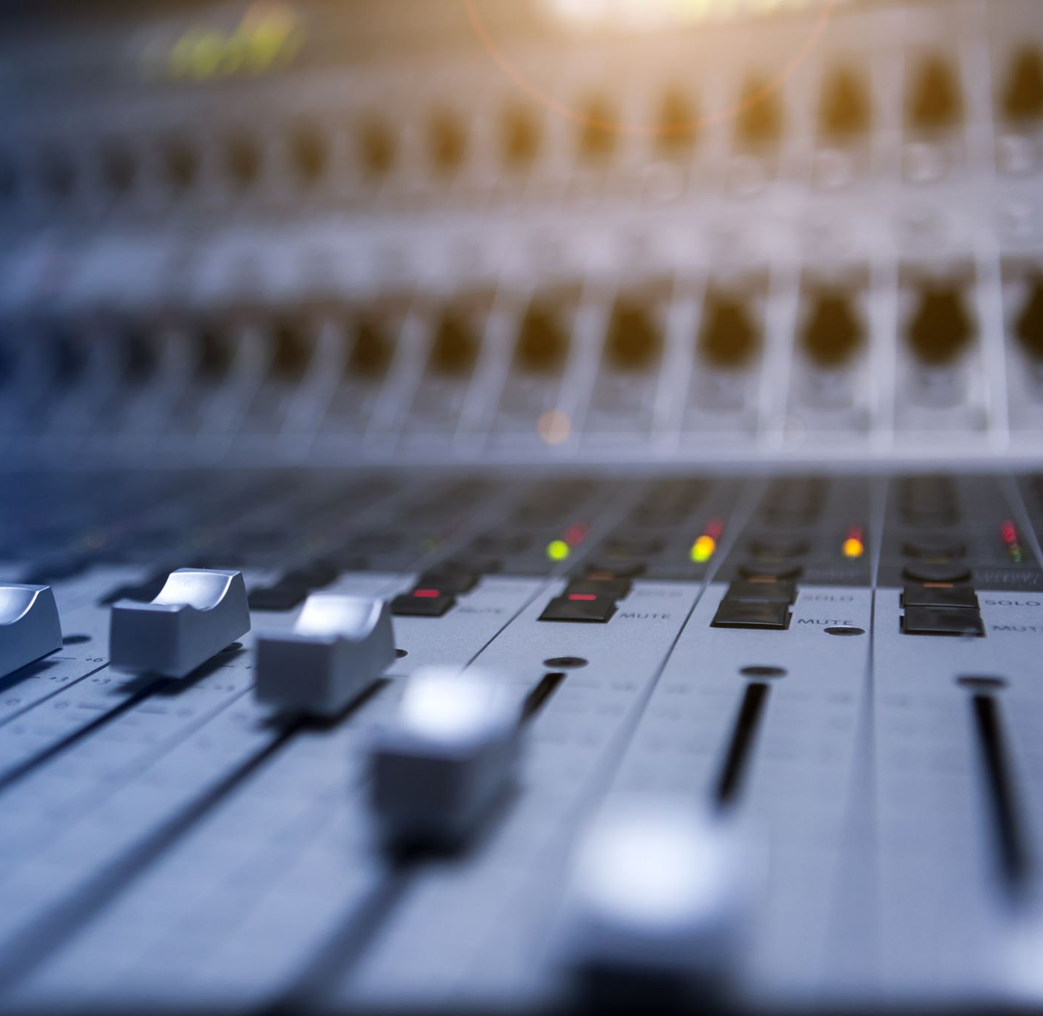
Audio Programming 2
Peter Dowsett
peter.dowsett@uwl.ac.uk

Slide 2
Today’s Lecture
What are systems with Memory?
What are Delay Line Effects?
What is a circular buffers and why are they necessary?
Fractional delay
Interpolation
Creating a delay effects in MATLAB

Slide 3
Systems with Memory
The gain and distortion algorithms we have written so far have all been memoryless systems. This means that the system only depends on the input to the system at the same time. These systems do not require the memory of previous time samples to process a signal.
However, many signal processing systems used in audio where the output at any time can depend on the input signal at a previous time. These systems require memory to store the input samples for later use. These are systems with memory. In fact, we have encountered a system with memory when we used parameter smoothing.

Slide 4
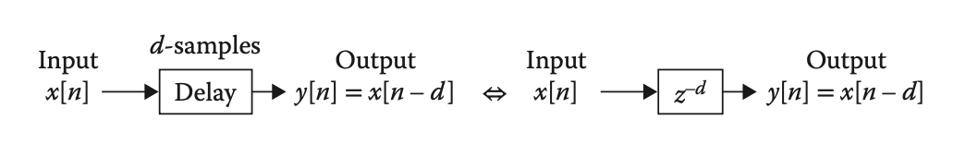

Delay Block Systems
Systems with memory have the ability to temporarily store a signal and delay it over time. A delay processing block receives a sample of the input signal at sample number n and stores this sample in memory for some number of samples, d. At sample number n + d, the output of a delay processing block is the input sample, x[n]. Therefore, when input sample x[n] is received by a delay processing block, the output of the block at the same time is the sample x[n − d], or the sample stored in memory for d samples In order to simplify the display of a block diagram, the notation $z^{−d}$ is used to represent a delay block of d samples. This convention comes from the z-plane.

Slide 5
Delay Buffers
For a system to “remember” past audio samples you need to be able store them in a computers memory. A collection of audio samples stored for the purpose of reading them back at a later date is called a delay buffer or delay line.

Slide 6
Delay Line Effects
Systems that utilise delay blocks are often called Delay Line Effects. Delay line effects are a cornerstone of DSP and can be used creatively to make many effects that extend past audible delays, including: Modulation effects - Phasing, flanging, Comb-
Filtering, Chorus Spatial effects - Reverb.
Spectral effects – EQ. The creating of Modulation effects will be covered in Week 14. This week we will concentrate on audible delays.

Slide 7
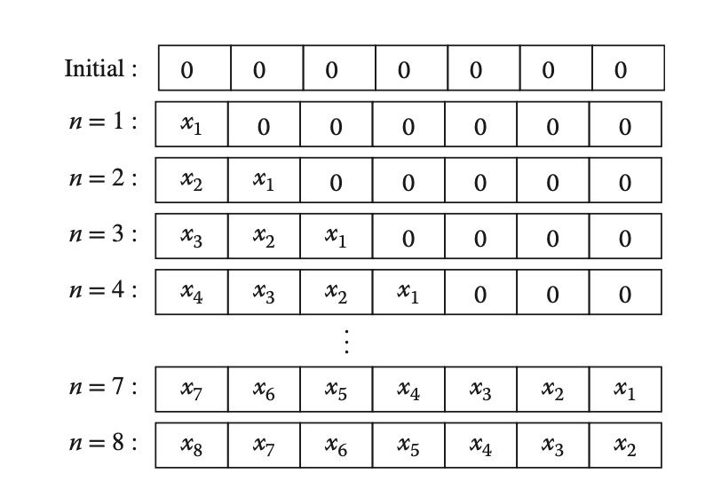
Linear Buffer
One way to create a delay buffer is to add a new sample into the start of the buffer at every sample period and shift the rest of the samples one place towards the back of the buffer. What are the problems with this approach?

Slide 8
Exercise 1
Create a 5 sample-long delay using Linear Buffer in MATLAB. This must use the the provided .wav impulse Please graph the input and output signals to confirm your solution works.

Slide 9
Circular Buffers
One approach to avoid the inefficient task of shifting samples in a linear buffer is to use a circular buffer. In a circular buffer, the value of each element is stored one time in its location and does not shift during an iteration. Instead, the relative location of the start of the buffer is changed during an iteration. Therefore, it is only necessary to change one value (the buffer index) during an iteration instead of every element of the buffer. The index of the delayed sample is determined relative to the current buffer index.

Slide 10
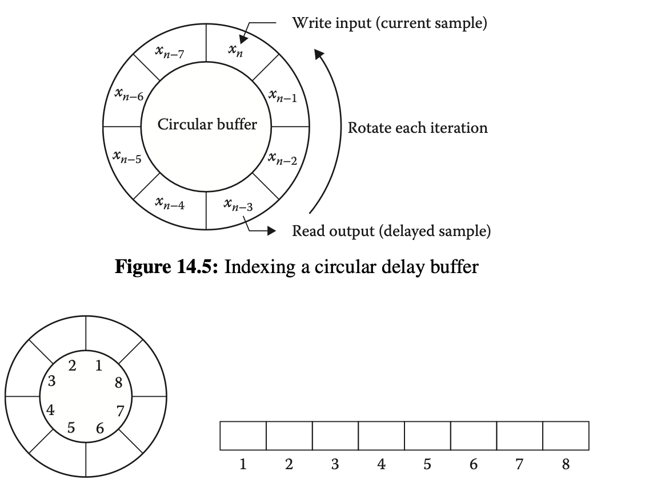
Circular Buffers Visually

Slide 11
Exercise 2
Create another 5 sample-long delay, using the provided .wav impulse, this time using a Circular Buffer in MATLAB. Please graph the input and output signals to confirm your solution works.

Slide 12
Delay Line Maths
At a sampling rate of 48 kHz, how many samples do you need to delay a signal by if you want it to played back half a second later? 48,000 * 0.5 = 24,000 samples How about 511.1 milliseconds (0.5111 seconds)? 48,000 * 0.5111 = 24532.8 samples What is the problem?

Slide 13
Fractional Delay
When a delay time falls between samples, you need a fractional delay line. To create a fractional delay line you need to use interpolation to get a value between samples. There are many different types of interpolation algorithms, but the idea behind it are the same. Interpolation uses existing data to estimate the value of an unknown point. In a delay line, this means using the samples surrounding the fractional point to estimate the value at that given moment in time.

Slide 14
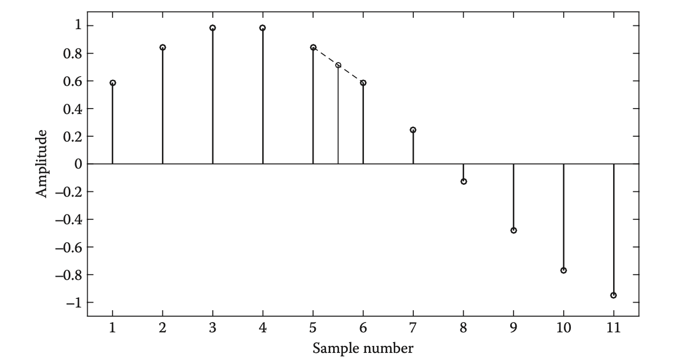
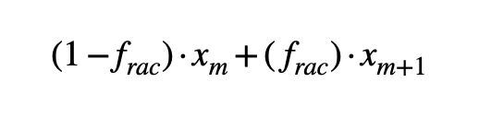
Linear Interpolation
For linear interpolation, the value of a signal between samples is estimated by a linear combination of the two closest samples:

Slide 15
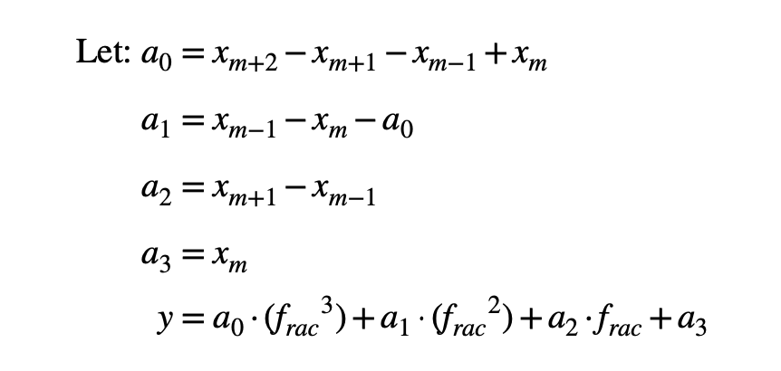
Cubic Interpolation
Cubic interpolation determines an estimated value of a signal between two samples by incorporating the amplitude of the four closest samples. In theory, by incorporating additional samples in the estimate, then a more accurate estimate can be made. However, an increase in computational complexity is necessary, as each estimate requires additional processing steps

Slide 16
Exercise 3
Use the following tabulated data to calculate the value of a 5.67 sample delay for both linear and cubic interpolations.
Sample No | 1 | 2 | 3 | 4 | 5 | 6 | 7 | 8 | 9
Value | 0.2 | 0.432 | 0.12 | 0.432 | 0.2 | 0.786 | 0.98 | 0.777 | 0.45

Slide 17
Exercise 4
Create a MATLAB delay plug-in which implements a fractional delay line. Additional Task: Make it switchable between linear and cubic interpolation. Additional Task: Create a VST using the Audio Toolbox, as shown in the Prototyping lecture.

